Slide 1
Event Sourcing
Lecturer: Ngo Huy Bien
Software Engineering Department
Faculty of Information Technology
VNUHCM - University of Science
Ho Chi Minh City, Vietnam
nhbien@fit.hcmus.edu.vn

Slide 2

Objectives
To implement a feature using event sourcing.
(To learn a new architecture style by yourself.)

Slide 3

Contents
Raw Events vs. Aggregated Data
Writes vs. Reads
Log
Event Stream
Data Integration
Event Sourcing
CQRS

Slide 4

References
Martin Kleppmann (2016). Making Sense of Stream Processing. O'Reilly Media.

Slide 5

Solving a Problem: The Hard Part
Input:
Story: As sponsors, we want the system to be able to run as fast and reliably as possible so that we can serve as many customers as we want.
Developer: Ngo Huy Bien.
Bonus:
UI + Architecture.
Scenarios, Domain Models + ERD.
Prototype + Proof of Concept
Output:
Source code → Problem solved.
Issue: Which tools? I haven't used these tools.

Slide 6

Why Learn a New Architecture Style?
1
Make money
Get a job (job requirement)
Startup (solving a problem)
Architecture selection
Faster development (Get a task done).
Easier modifiability and extensibility.
Better security and scalability.
Hobby
Problem/need.
Open yourself up to new ideas and approaches.
2

Slide 7
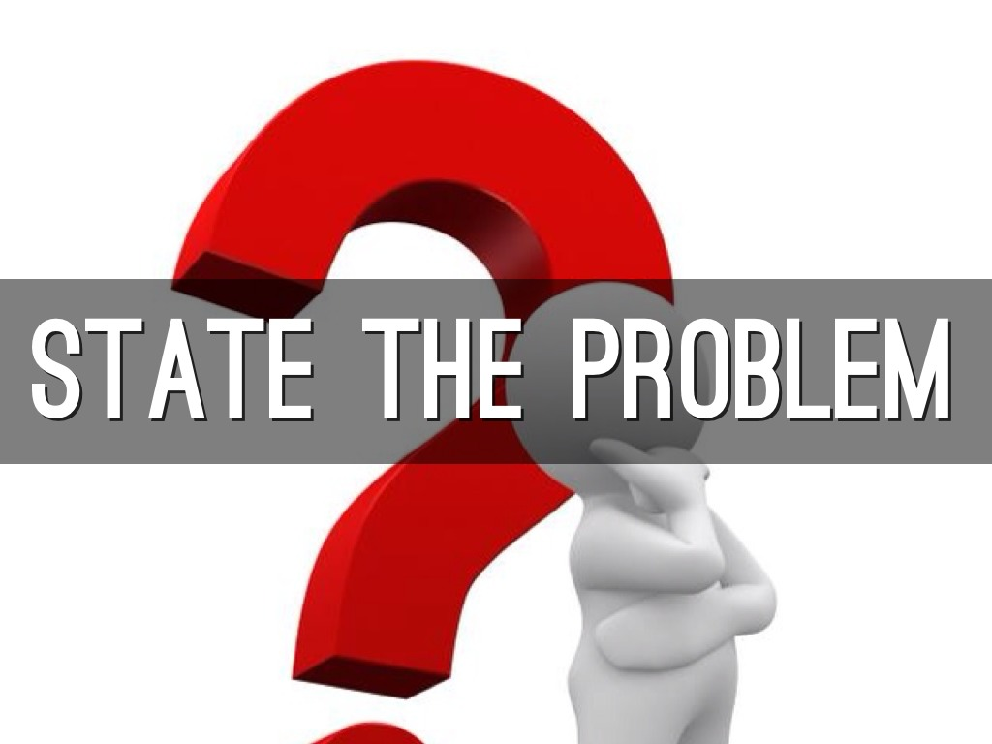

Identify a Concrete Problem
Implement a feature using CQRS.
Implement a feature using Event Sourcing.

Slide 8

Typical Procedure
Clarify domain-specific terminologies (CQRS? Event Sourcing?, EventStoreDB? Kafka?)
Find a tutorial (or a mentor).
Install and configure the tools.
Reproduce, test and clarify the tutorial code.

Slide 9


Slide 10

Customer Management Demo
Source: https://github.com/EduardoPires/EquinoxProject
Online demo: https://equinoxproject.azurewebsites.net/
Create Customer Management App (CRUD App)
First name
Last name
ID
Date of birth
Email
Scalability (Performance)?
Auditability?

Slide 11

Why Event Sourcing?
Audit log
Why not use "traditional" log?
How to prove the authenticity of the log?
Restore the system state using the log.
Big data
Performance optimization
Writes vs. reads
Complexity
Components dependency

Slide 13
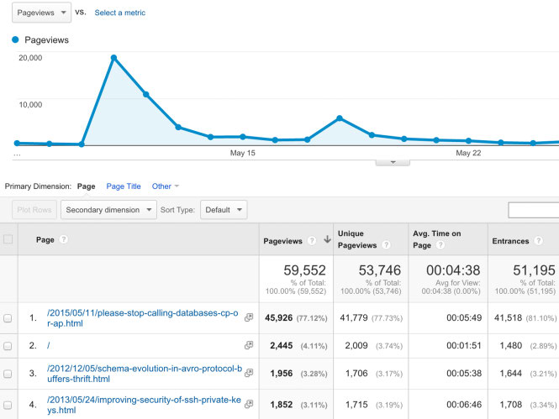
Counting Page Visitors [1]
Google Analytics is a bit of JavaScript that you can put on your website, and that keeps track of which pages have been viewed by which visitors.

Slide 14
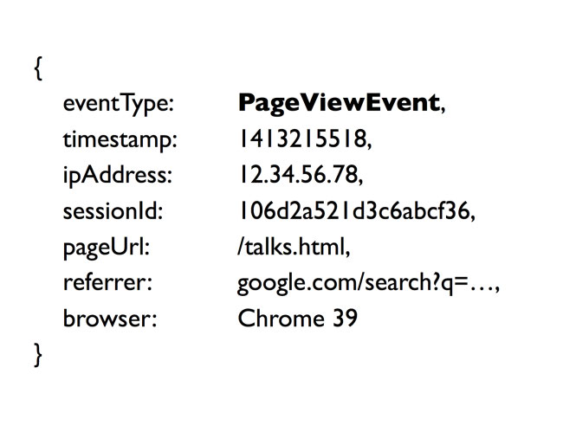
Record Page View Event
How would you implement something like Google Analytics?
First take the input to the system.
Every time a user views a page, we need to log an event to record that fact.
A page view event might look something like the example (using a kind of pseudo-JSON).

Slide 15
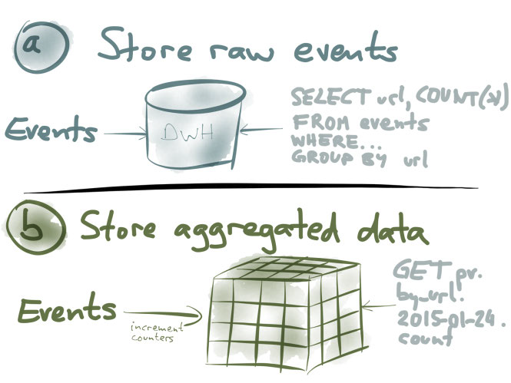
Implement Reporting

Slide 16
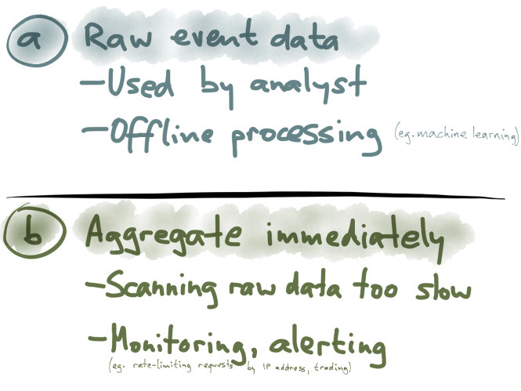
Raw Events vs. Aggregated Data
Raw events: you have maximum flexibility for analysis.
Aggregated data: you need to make decisions or react to things in real time. E.g. for stock market trading, you also need to be quick.

Slide 18
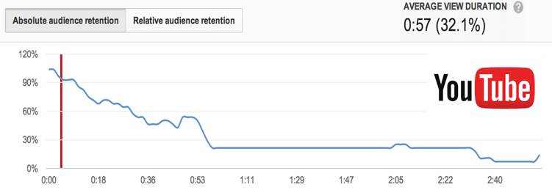
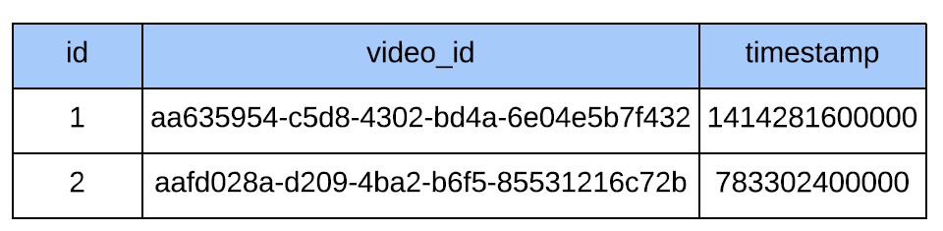
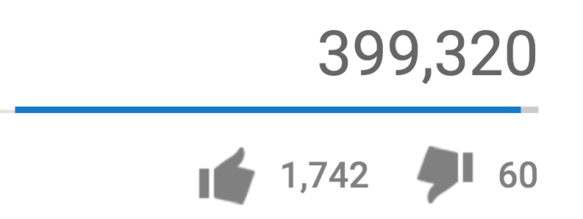
Counting Video Views Example
Raw Events or Aggregated Data?

Slide 20
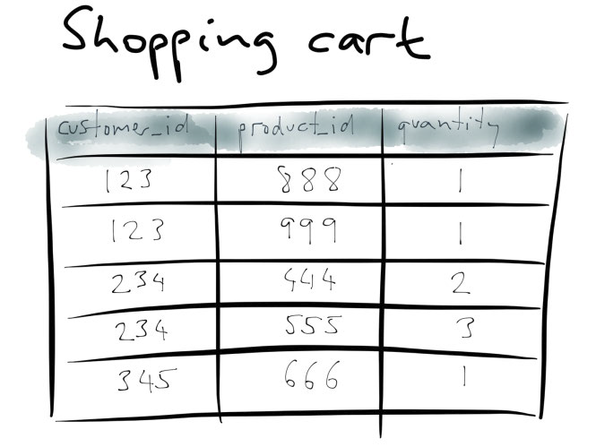
Shopping Cart Example

Slide 21
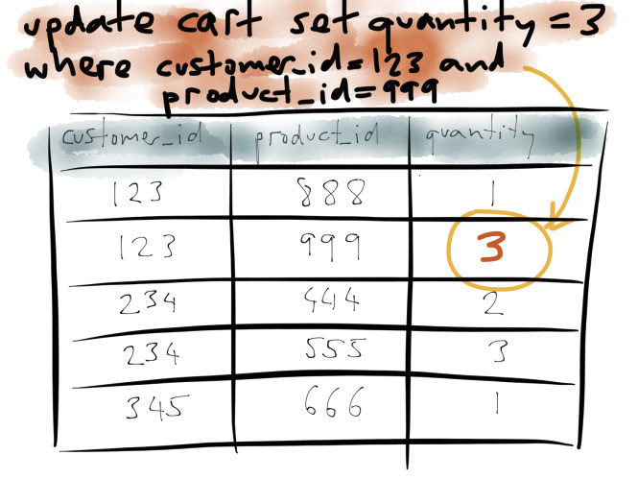
Update a Shopping Cart

Slide 22
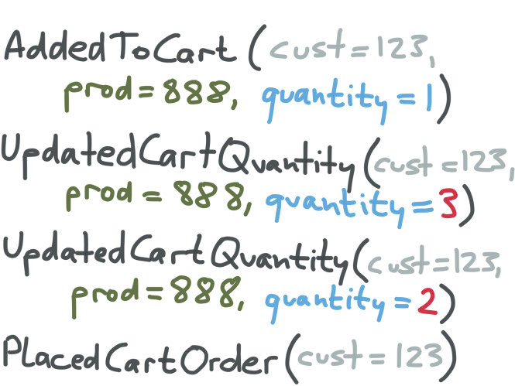
Record Shopping Cart Changes

Slide 23
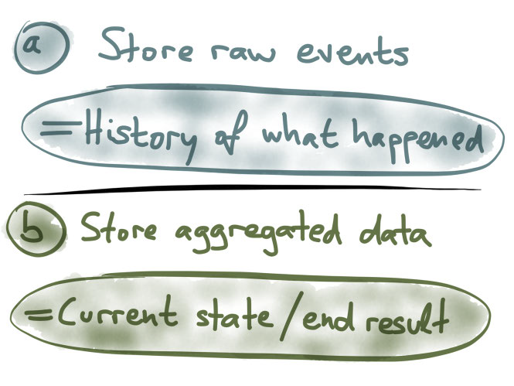
Raw Events vs. Aggregated Data

Slide 25
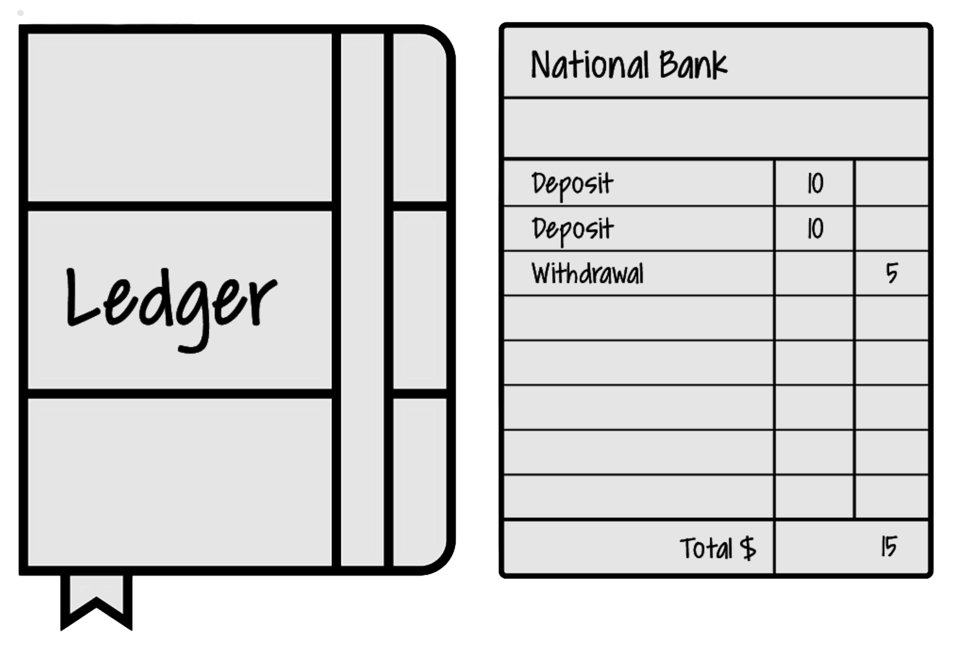
Bank Account Example

Slide 27
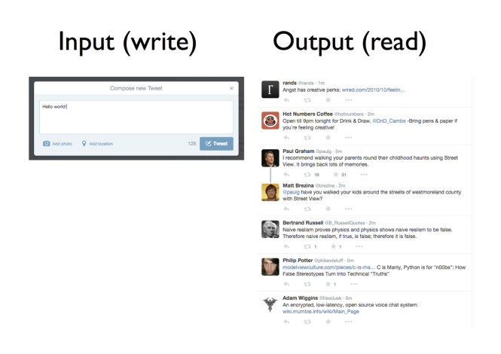
Twitter Writes vs. Reads
Twitter's input: a tweet button. Twitter's output: a timeline.

Slide 28
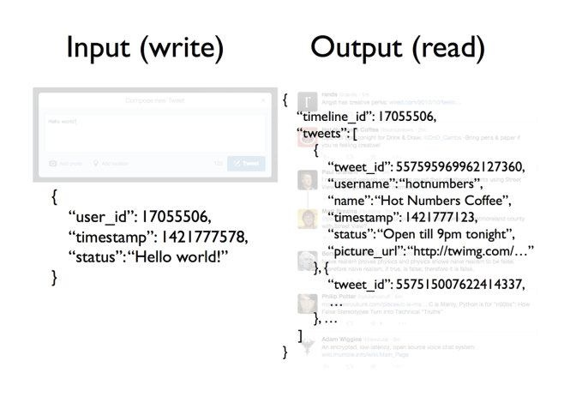
Data Forms
Data is written in a simple form; it is read in a much more complex form.

Slide 29
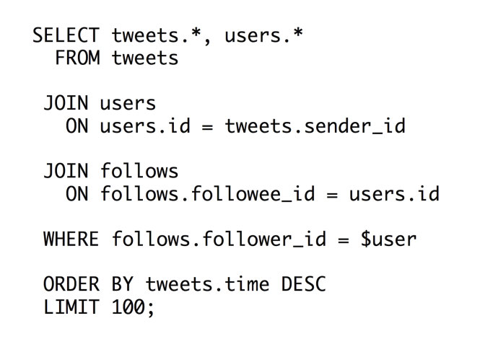
A Naïve Data Output Solution
Generating a timeline of tweets by using SQL.

Slide 30
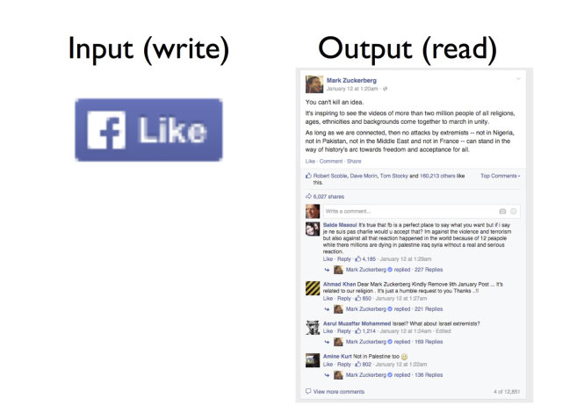
Facebook Writes vs. Reads
Facebook's input: a “like” button.
Facebook's output: a timeline post, liked by lots of people.

Slide 31
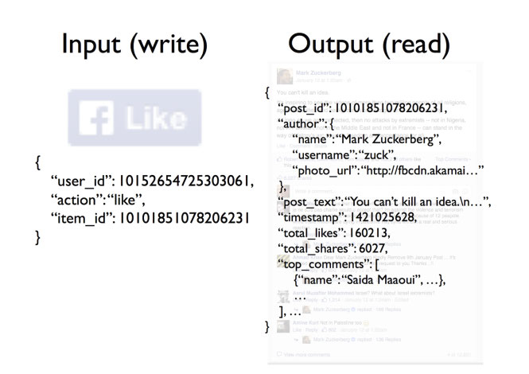
Data Forms
When you view a Facebook post, hundreds of thousands of events may have been aggregated in its making.

Slide 32
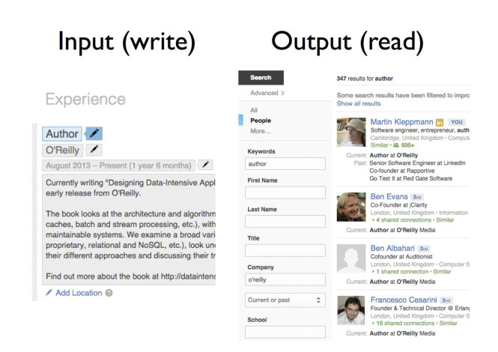
LinkedIn Writes vs. Reads
LinkedIn's input: your profile edits.
LinkedIn's output: a search engine over everybody's profiles.

Slide 33
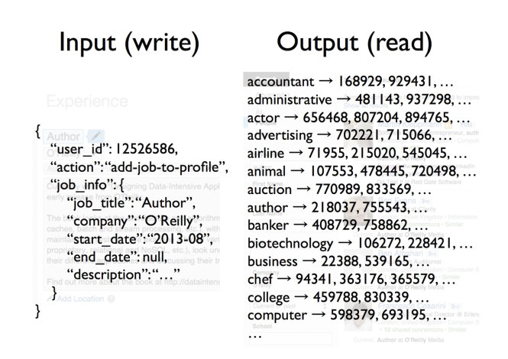
Data Forms
A full-text index summarizes which profiles contain which keywords; when a profile is updated, the index needs to be updated accordingly.

Slide 34
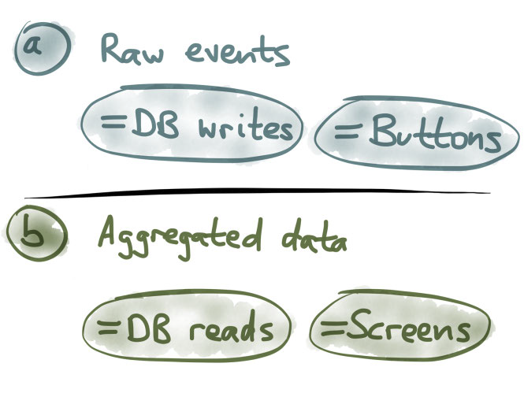
Writes vs. Reads
Events are optimized for writes; aggregated values are optimized for reads.

Slide 36
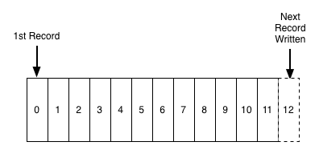
What is a Log?
https://engineering.linkedin.com/distributed-systems/log-what-every-software-engineer-should-know-about-real-time-datas-unifying
A log is perhaps the simplest possible storage abstraction.
It is an append-only, totally-ordered sequence of records ordered by time.
It looks like this:

Slide 37
"Application" Log vs. "Data" Log
Another definition of logging—"application logging"—the unstructured error messages or trace info an application might write out to a local file using syslog or log4j.
The application log is a degenerative form of the log concept being described.
The biggest difference is that text logs are meant to be primarily for humans to read and the "journal" or "data logs" being described are built for programmatic access.

Slide 38
What is Event Stream?
It is a collection of events that happen to an entity (e.g. an URL, a Bank Account).
An event stream is usually stored as a Log.

Slide 39
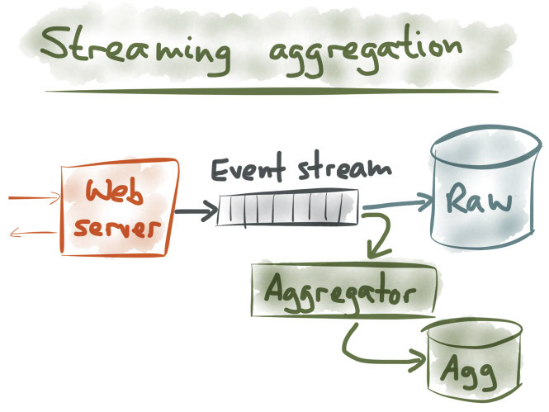
Why Don't Use Both?

Slide 40
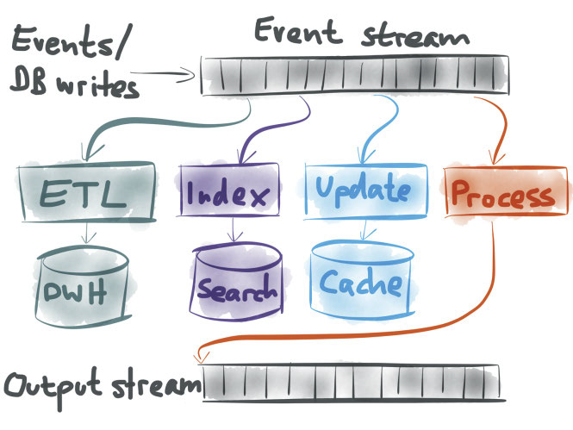
How to Use an Event Stream?

Slide 42
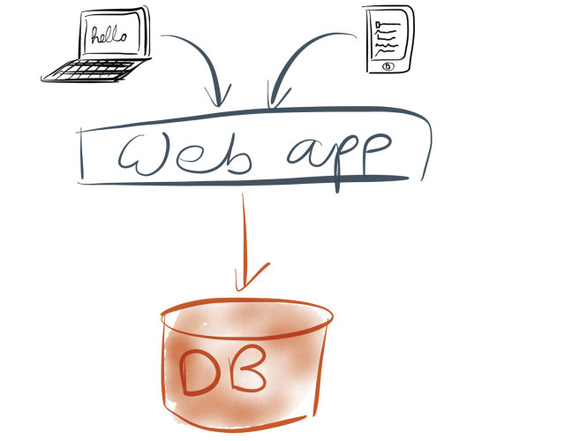
Web Application: Version 1
One web app, one database: life is simple.
Whenever the application wants to remember something for the future, it stores it in a database.
Accordingly, whenever the application wants to look up something that it stored previously, it queries the database.

Slide 43
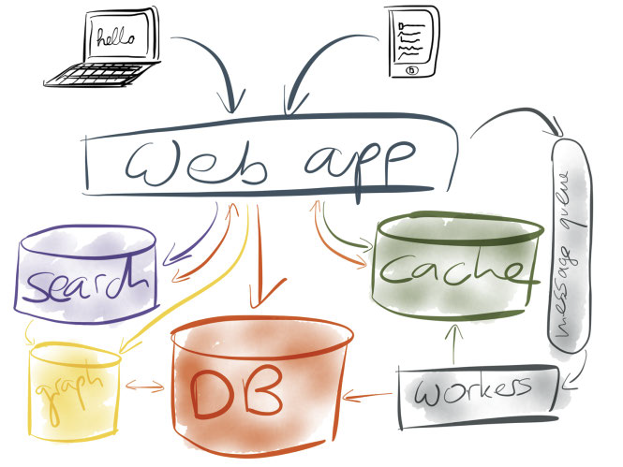
Web Application: Version 2
More users, making more requests → cache.
Slow search queries → full-text search.
Graph operations that are not efficient on a relational or document database → graph database.
Expensive operations → message queue and workers.

Slide 44
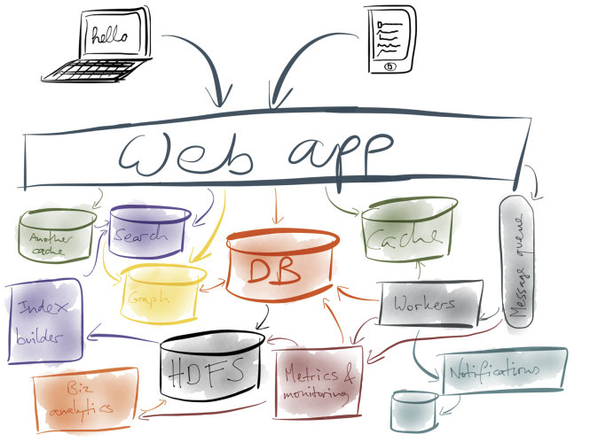
Web Application: Version 3
Send notifications, such as email or push notifications to users → Notification system.
A lot of data that needs to be analyzed → HDFS.
Search & HDFS syncronization → Index builder.
A lot of systems and services → Metrics and monitoring.

Slide 45
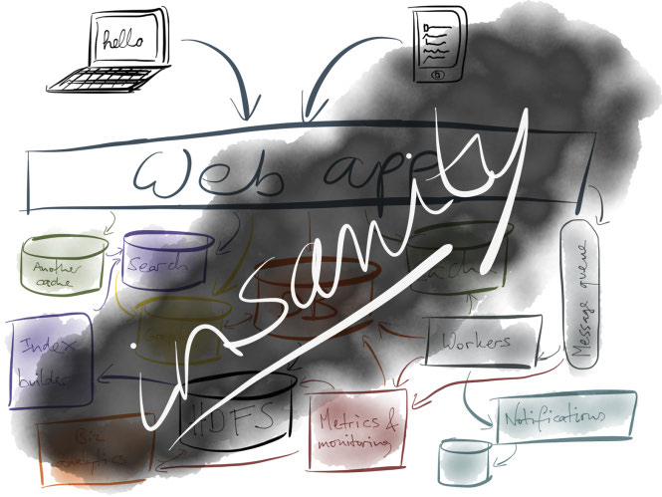
Web Application: Version 4
More and more features are requested (multitenancy, business workflow builder, legacy systems integration, external systems integration) → more and more services.
A system with many interdependent components becomes very complex and difficult to manage and understand.

Slide 46
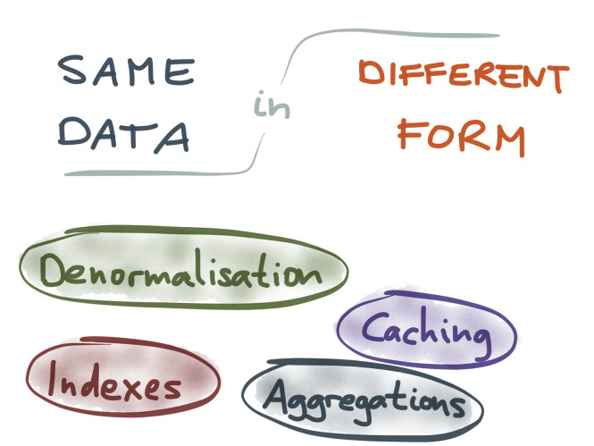
The Real Trouble
Also, as a system grows, you need a way of decomposing it into smaller components in order to keep it manageable.
That's what microservices are all about.
But, if your system becomes a tangled mess of interdependent components, that's not manageable either.
Simply having many different storage systems is not a problem in and of itself: if they were all independent from one another, it wouldn't be a big deal.
The real trouble here is that many of them end up containing the same data, or related data, but in different form.

Slide 47
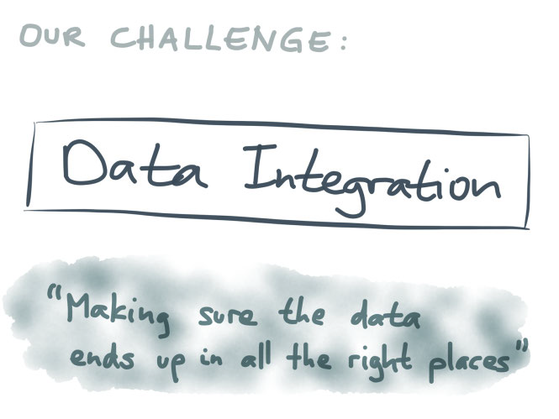
Our Challenge
The problem of data integration: keeping data systems synchronized.

Slide 49
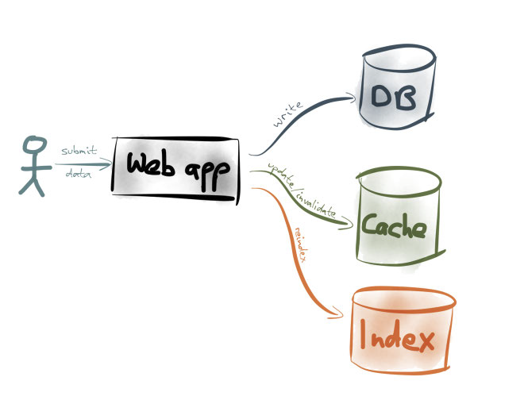
An Integration Approach: Dual Writes
It's the responsibility of your application code to update data in all the appropriate places.

Slide 50
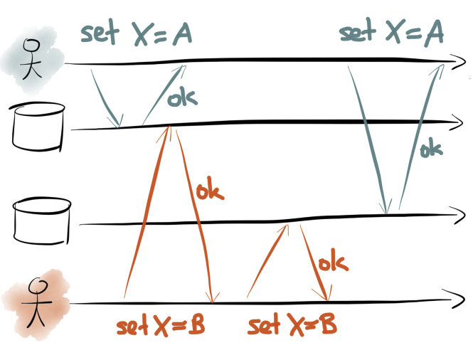
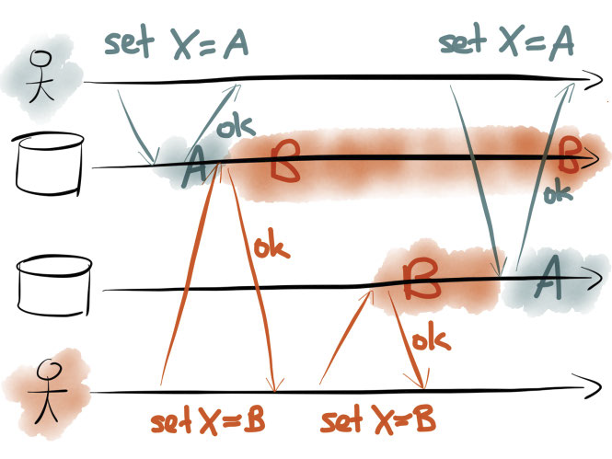
Dual Writes Issue: Race Conditions
Two different clients concurrently writing to the same key, using dual writes.
A race condition with dual writes leads to perpetual inconsistency between two datastores.

Slide 51
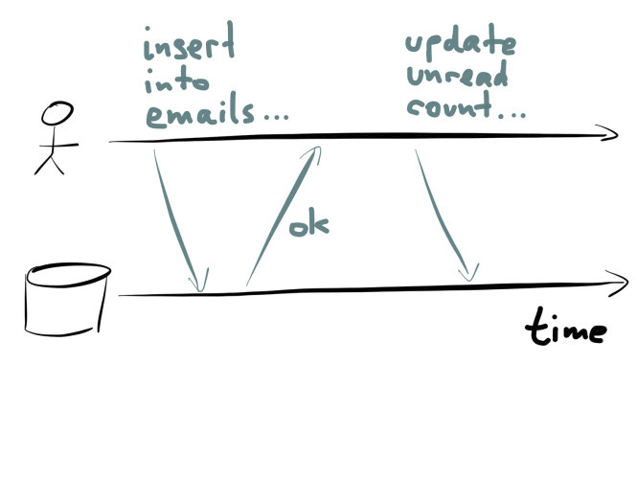
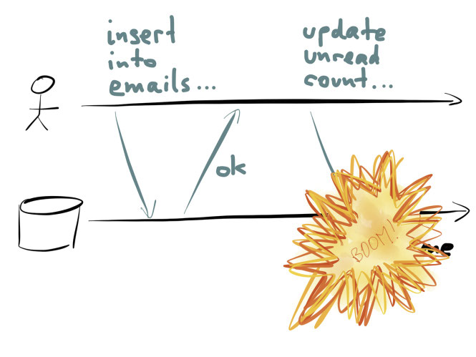
Dual Writes Issue: Partial Failures
One write succeeds; the other write fails. What now?
Some systems support distributed transactions, based on 2-phase commit, for example.
However, many datastores nowadays don't support it, and even if they did, it's not clear whether distributed transactions are a good idea in the first place.

Slide 53
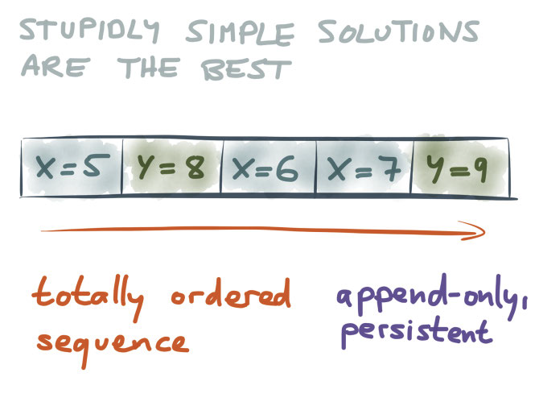
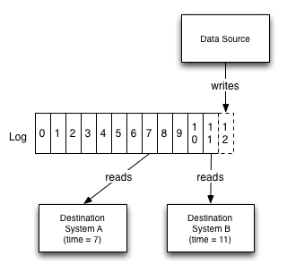
Another Integration Approach: Log
Store all your writes in a fixed order, and apply them in that fixed order to the various places they need to go.

Slide 54
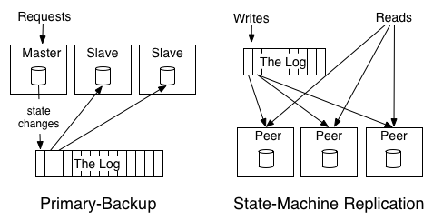
Other Example Logs
Primary-backup replication: elect one replica as the leader and allow this leader to process requests.
State machine replication: an active-active model where a log of the incoming requests is kept and each replica processes each request.

Slide 55

Distributed Log Software
Install, run, and execute CRUD commands.
EventStoreDB
PostgreSQL with JSONB
Apache Kafka
RabbitMQ
Amazon Kinesis (cloud based solution)
Microsoft Azure Event Hubs (cloud based solution)
Google Pub/Sub (cloud based solution)

Slide 56
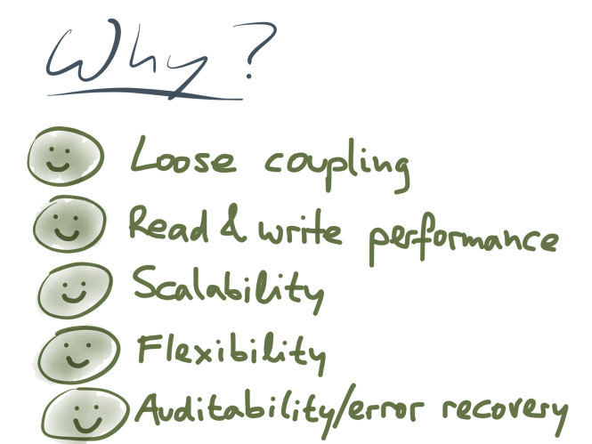
Why Use Distributed Log (aka Event Sourcing)?

Slide 58

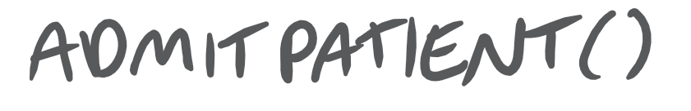
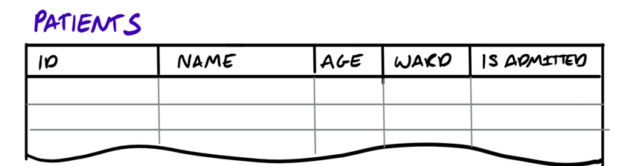
Traditional Storage Approach
Save object state (value of properties) in tables or documents of RDMS or NoSQL.
Patient
Id: 04e3b534-8a40-4180-a7ed-d5afaa45a858
Name: Tony Ferguson
Age: 32
Ward: 10
IsAdmitted: true
04e3b534-8a40…
Tony Ferguson
32
10
true

Slide 59

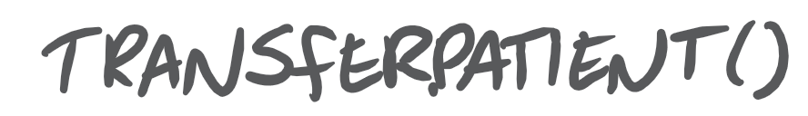

Transfer Patient
Patient
Id: 04e3b534-8a40-4180-a7ed-d5afaa45a858
Name: Tony Ferguson
Age: 32
Ward: 76
IsAdmitted: true
04e3b534-8a40…
Tony Ferguson
32
76
true

Slide 60


Transfer Patient Once More Time
Patient
Id: 04e3b534-8a40-4180-a7ed-d5afaa45a858
Name: Tony Ferguson
Age: 32
Ward: 34
IsAdmitted: true
04e3b534-8a40…
Tony Ferguson
32
34
true

Slide 61

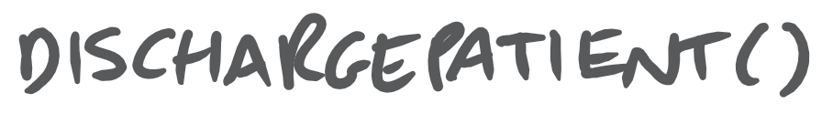

Discharge Patient
Patient
Id: 04e3b534-8a40-4180-a7ed-d5afaa45a858
Name: Tony Ferguson
Age: 32
Ward: null
IsAdmitted: false
DischargePatient()
04e3b534-8a40…
Tony Ferguson
32
NULL
true

Slide 63



Event Sourcing Approach
Saving objects
Create an event for every state change of the object.
Persist stream of events, preserving event order.
Patient
Id: 04e3b534-8a40-4180-a7ed-d5afaa45a858
Name: Tony Ferguson
Age: 32
Ward: 10
IsAdmitted: true
PatientAdmitted
Id: 04e3b534-8a40-41…
Name: Tony Ferguson
Age: 32
Ward: 10
What is an event
technically?

Slide 64
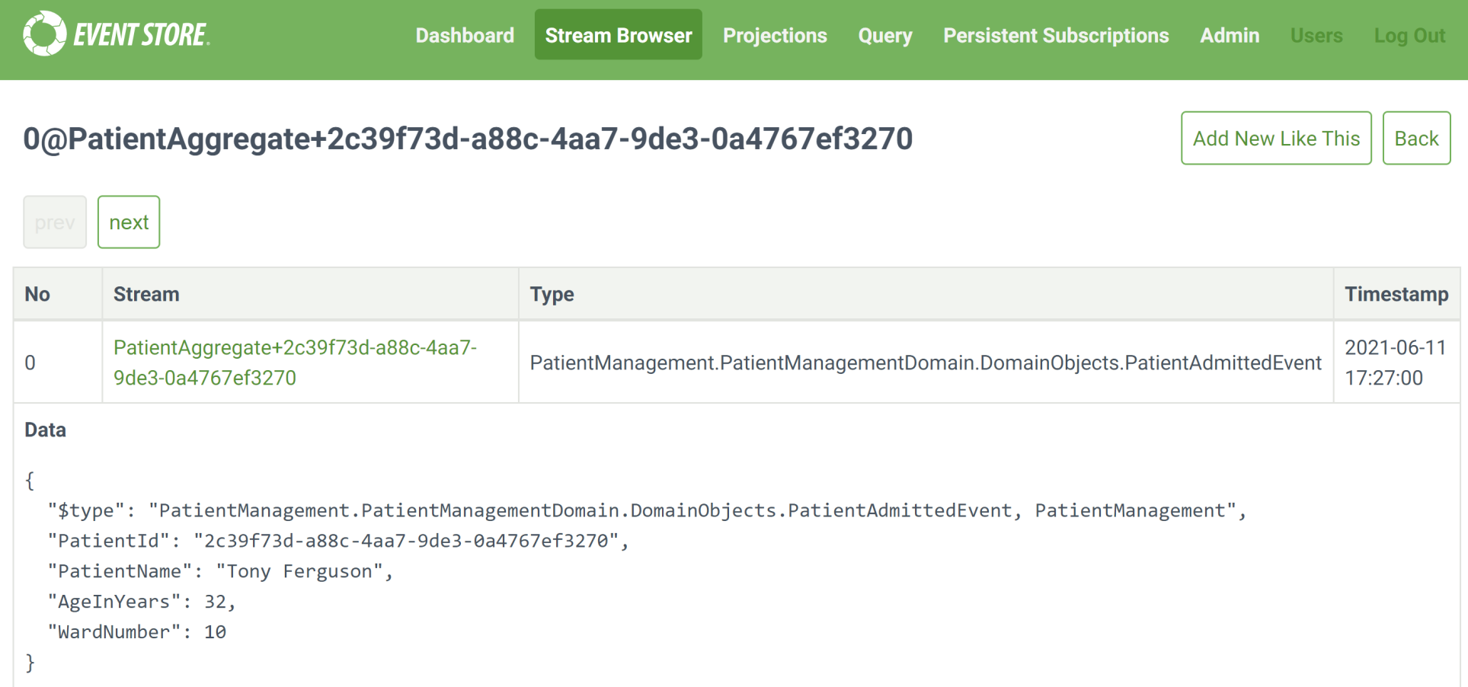

How is the Event Stored?

Slide 65
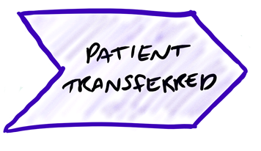
Transfer Patient
Patient
Id: 04e3b534-8a40-4180-a7ed-d5afaa45a858
Name: Tony Ferguson
Age: 32
Ward: 76
IsAdmitted: true
PatientTransferred
Id: 04e3b534-8a40-41…
ToWard: 76

Slide 66
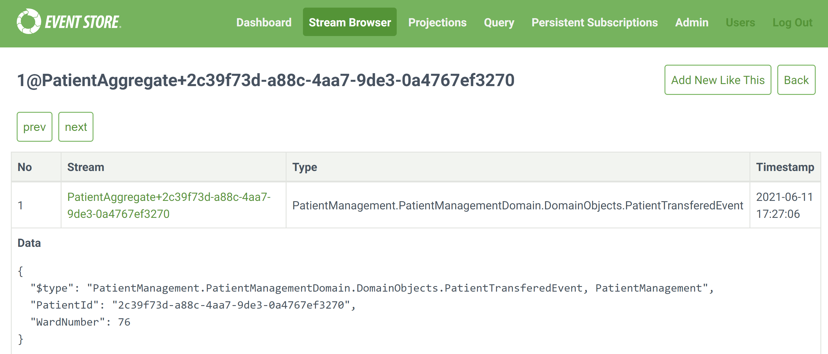
How is the Event Stored?

Slide 67

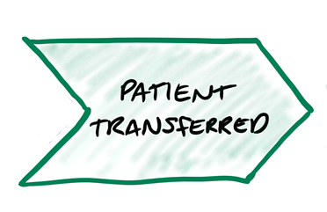
Transfer Patient Once More Time
Patient
Id: 04e3b534-8a40-4180-a7ed-d5afaa45a858
Name: Tony Ferguson
Age: 32
Ward: 34
IsAdmitted: true
PatientTransferred
Id: 04e3b534-8a40-41…
ToWard: 34

Slide 68
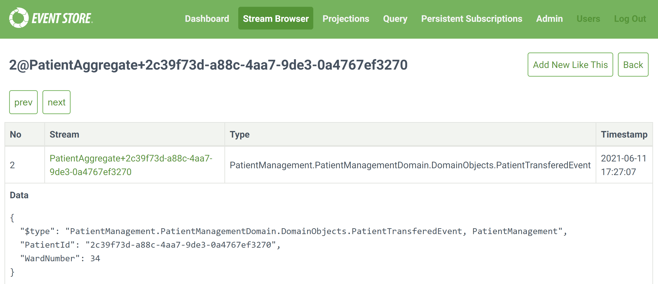
How is the Event Stored?

Slide 69

Discharge Patient
Patient
Id: 04e3b534-8a40-4180-a7ed-d5afaa45a858
Name: Tony Ferguson
Age: 32
Ward: null
IsAdmitted: false
PatientDischarged
Id: 04e3b534-8a4a…
Ward: null
IsAdmitted: false
PatientAdmitted

Slide 70
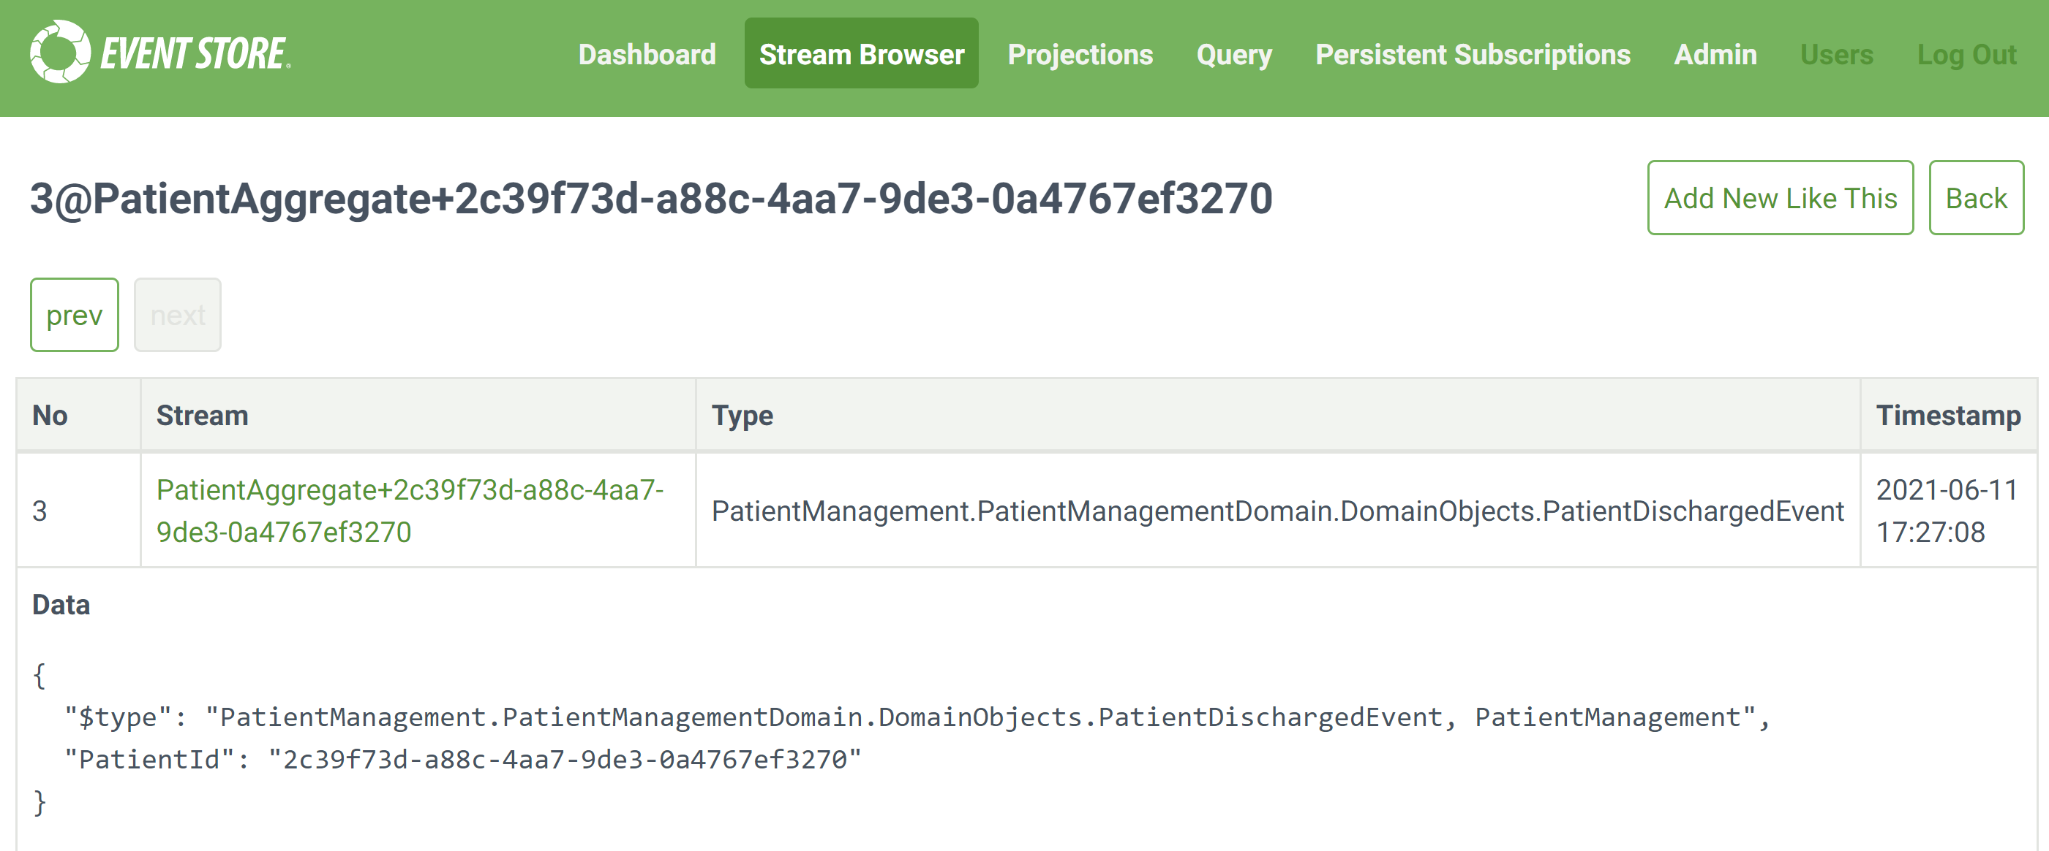
How is the Event Stored?

Slide 71

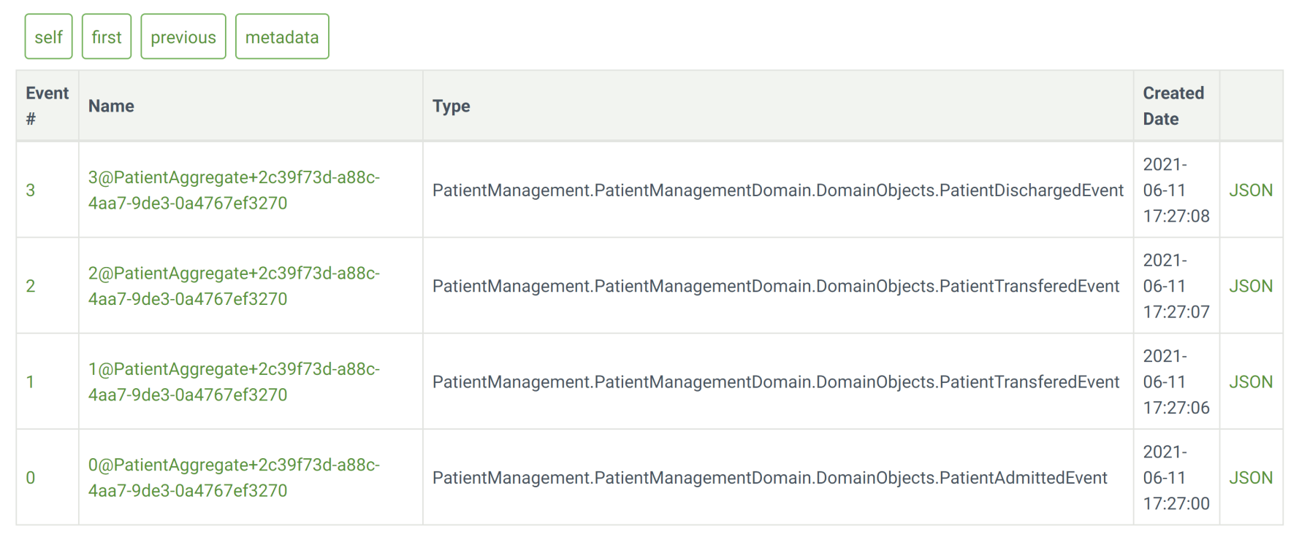
How Many Event Types for an Object?
Event types vs. Events.
Your choice. Depending on your domain. No rules.

Slide 72
How are Events Stored?
Events are often stored as schema-less data, because different event types often have different properties.

Slide 74
Demo: Patient Events (Domain)
IEvent.cs
PatientAdmittedEvent.cs (just a DTO)
PatientTransferedEvent.cs (just a DTO too)
PatientDischargedEvent.cs (just a DTO too)
IAggregateRoot.cs, AggregateRoot.cs
PatientAggregate.cs (contains the latest Patient information)
events
eventHandlers
AggregateRepository.cs
EventStoreClient client
Save: client.AppendToStreamAsync
Get: client.ReadStreamAsync

Slide 75
Demo: Patient Commands
Entry point: TestConsole → Program.cs
PatientCommandHandler.cs
Contains AdmitPatientCommand (just a Command DTO)
Contains TransferPatientCommand (just a Command DTO)
Contains DischargePatientCommand (just a Command DTO)
Updates PatientAggregate with Command DTO information.
Uses AggregateRepository to store Command DTO information.
CommandHandlerMap.cs: collection of Command Handlers. PatientCommandHandler is one of Command Handlers.
CommandDispatcher.cs: retrieves Command DTO and get the corresponding handler in CommandHandlerMap to execute it.

Slide 76
Admit Patient Command Handler
PatientCommandHandler.cs
Create a "blank" object instance.
Retrieve the first event for the object.
Apply the event to the "blank" object instance.
Save the event to the event store.

Slide 77


Admit Patient Command Handler (Encounter)

Slide 78
Transfer Patient Command Handler
PatientCommandHandler.cs
Create a "blank" object instance.
Retrieve the events for the object id.
Subsequently apply the events to the "blank" object instance.
Execute business rules (TransferPatient)
Save the events to the event store.

Slide 79
Discharge Patient Command Handler
PatientCommandHandler.cs
Create a "blank" object instance.
Retrieve the events for the object id.
Subsequently apply the events to the "blank" object instance.
Execute business rules (DischargePatient)
Save the events to the event store.

Slide 80

Executing a Handler
Dispatcher input: Admit Patient.
Dispatcher execution: Admin Handler.

Slide 82


General Approach for Aggregate
Create a "blank" object instance.
Retrieve the events for the object id.
Subsequently apply the events to a "blank" object instance.
CREATE

Slide 83


PatientAdmitted
Id: 04e3b534-8a40-41…
Name: Tony Ferguson
Age: 32
Ward: 10
Apply the First Event
PatientTransferred
Id: 04e3b534-8a40-41…
ToWard: 76
04e3b534-8a40…
Tony Ferguson
32
10
PatientTransferred
Id: 04e3b534-8a40-41…
ToWard: 34
PatientDischarged
Id: 04e3b534-8a4a…
Ward: null
IsAdmitted: false
Notes:
83

Slide 84
PatientAdmitted
Id: 04e3b534-8a40-41…
Name: Tony Ferguson
Age: 32
Ward: 10
Apply the Second Event
PatientTransferred
Id: 04e3b534-8a40-41…
ToWard: 76
PatientTransferred
Id: 04e3b534-8a40-41…
ToWard: 34
04e3b534-8a40…
Tony Ferguson
32
76
PatientDischarged
Id: 04e3b534-8a4a…
Ward: null
IsAdmitted: false
Notes:
84

Slide 85
PatientAdmitted
Id: 04e3b534-8a40-41…
Name: Tony Ferguson
Age: 32
Ward: 10
04e3b534-8a40…
Tony Ferguson
32
34
PatientTransferred
Id: 04e3b534-8a40-41…
ToWard: 76
PatientTransferred
Id: 04e3b534-8a40-41…
ToWard: 34
Apply the Third Event
PatientDischarged
Id: 04e3b534-8a4a…
Ward: null
IsAdmitted: false
Notes:
85

Slide 86
Apply Final Event
PatientAdmitted
Id: 04e3b534-8a40-41…
Name: Tony Ferguson
Age: 32
Ward: 10
PatientTransferred
Id: 04e3b534-8a40-41…
ToWard: 76
04e3b534-8a40…
Tony Ferguson
32
NULL
PatientTransferred
Id: 04e3b534-8a40-41…
ToWard: 34
PatientDischarged
Id: 04e3b534-8a4a…
Ward: null
IsAdmitted: false
Apply the Final Event
Notes:
86

Slide 87

Another Example

Slide 89



CQRS + Event Sourcing

Slide 90

Demo: Projections (Views)
Ward view: Patient wards.
Demographic view: Patient ages.

Slide 91

Patient Ward View

Slide 92

Patient Demographic View

Slide 93


Projection Manager

Slide 94
Projection Manager Code
Program.cs: Sets up connections to RavenDB and Event Store.
Projection.cs: Base methods for all projections.
Handle
WardViewProjection.cs: Saves data to RavenDB for ward view.
PatientDemographicProjection.cs: Saves data to RavenDB for demographic view.
ProjectionManager.cs: Subscribes to event store and registers Projections to write data to RavenDB, then updates stream position for each Projection.

Slide 95

MongoDB Patient Ward View

Slide 96

MongoDB Patient Demographic View

Slide 98

How to Update an Object?
Just save an event, e.g. PatientNameChanged event.

Slide 99

How to Delete an Object?
Just save an event, e.g. PatientDeleted event.

Slide 100

Writing to a Stream

Slide 101

Snapshotting

Slide 102

How to Handle Side-Effects?
E-mails sent twice, payment processed twice when replaying the events.
Solution 1:
Separate side-effect and state change.
Only the state change event is being replayed.
Solution 2:
When events are created (only once), side-effects are triggered by event-listeners.

Slide 103

Event Sourcing vs. Consistency
https://martinfowler.com/articles/microservice-trade-offs.html#consistency
You make an update to something, it refreshes your screen and the update is missing.
You wait a minute or two, hit refresh, and there it is.
This is a very irritating usability problem, and is almost certainly due to the perils of eventual consistency.

Slide 104

How to Provide Feedback to User?
Attention: Do not use command processors for both storing and restoring states. It may complicate the command processors. Solution 1: Use snapshots when possible.

Slide 105

Writing to Projection
Do NOT do it.
If that projection write fails — what happens?
Retry logic?
Partial failure?
Compensating actions?
You’ve just added complexity to what should be a simple, deterministic, and transactional part of the system.
Let’s say your projection is down during the write. If your logic was dependent on that projection being up-to-date right away (e.g., for returning a response), you’re hosed. You may break the purity and replayability of event sourcing.
Better to let projections update asynchronously, and keep your write path clean and pure.

Slide 106

How to Provide Feedback to User? (II)
Solution 2: Use Post/Redirect/Get pattern.

Slide 107

Unbound List of Events

Slide 108

Fixing Unbound List

Slide 109

Versioning

Slide 111
CQRS (I)
http://codebetter.com/gregyoung/2010/02/16/cqrs-task-based-uis-event-sourcing-agh/
CQRS: Command and Query Responsibility Segregation.
When most people talk about CQRS they are really speaking about applying the CQRS pattern to the object that represents the service boundary of the application. Consider the following pseudo-code service definition.
CustomerService
void MakeCustomerPreferred(CustomerId)
Customer GetCustomer(CustomerId)
CustomerSet GetCustomersWithName(Name)
CustomerSet GetPreferredCustomers()
void ChangeCustomerLocale(CustomerId, NewLocale)
void CreateCustomer(Customer)
void EditCustomerDetails(CustomerDetails)

Slide 112
CQRS (II)
Applying CQRS on this would result in two services:
CustomerWriteService
void MakeCustomerPreferred(CustomerId)
void ChangeCustomerLocale(CustomerId, NewLocale)
void CreateCustomer(Customer)
void EditCustomerDetails(CustomerDetails)
CustomerReadService
Customer GetCustomer(CustomerId)
CustomerSet GetCustomersWithName(Name)
CustomerSet GetPreferredCustomers()
That is it. That is the entirety of the CQRS pattern.

Slide 113

Traditional Architecture
https://kariera.future-processing.pl/blog/cqrs-simple-architecture/

Slide 114

Commands and Queries
Separate business logic into Commands and Queries.
Command – Firing command is the only way to change the state of the system.
Query – Reading the state of the system, filtering, aggregating and transforming data to deliver it in the most useful format.

Slide 115

READ and WRITE Models
Separate domain model into READ and WRITE models.

Slide 116

Direct READ Model
Queries can retrieve data directly from database instead of relying on ORM.

Slide 117

READ DB and WRITE DB
READ model is virtualized by DB Views.
READ DB is updated by events.

Slide 118

READ DB and Event Stream
READ model is virtualized by DB Views.
READ DB is subscribed to event stream.

Slide 119

Why CQRS?
The largest possible benefit though is that it recognizes that there are different architectural properties when dealing with commands and queries … for example it allows us to host the two services differently, e.g. we can host the read service on 25 servers and the write service on two servers.
The processing of commands and queries is fundamentally asymmetrical, and scaling the services symmetrically does not make a lot of sense.

Slide 121

Event Sourcing
https://martinfowler.com/eaaDev/EventSourcing.html
Need:
We can query an application's state to find out the current state of the world.
However there are times when we don't just want to see where we are, we also want to know how we got there.
Event Sourcing: Capture all changes to an application state as a sequence of events.

Slide 122
Event Sourcing vs. Event Collaboration
https://martinfowler.com/eaaDev/EventCollaboration.html
Need: How to add new components to a system without existing components needing to know anything about the new arrivals.
Event Collaboration: Multiple components work together by communicating with each other by sending events when their internal state changes.
Attention: Do not use event store as message bus.
Separate business history facts from technical event notifications.

Slide 123
Event-Driven Meanings
https://www.youtube.com/watch?v=STKCRSUsyP0
https://martinfowler.com/articles/201701-event-driven.html
Event Notification. This happens when a system sends event messages to notify other systems of a change in its domain.
Event-Carried State Transfer. This pattern shows up when you want to update clients of a system in such a way that they don't need to contact the source system in order to do further work.
Event-Sourcing. The core idea of event sourcing is that whenever we make a change to the state of a system, we record that state change as an event, and we can confidently rebuild the system state by reprocessing the events at any time in the future.

Slide 124
Case Studies
An Introduction to CQRS and Event Sourcing Patterns (2017)
https://www.youtube.com/watch?v=9a1PqwFrMP0
https://github.com/mat-mcloughlin/PatientMangement
Netflix Downloads (2017)
https://www.youtube.com/watch?v=rsSld8NycCU
Netflix Downloads (2018)
https://www.youtube.com/watch?v=9tNZ4hAOhzs
Mistakes Made Adopting Event Sourcing (2020)
https://www.youtube.com/watch?v=osk0ZBdBbx4
https://boringtechnology.club/

Slide 125
Books with Code
Java
Alexander Dean and Valentin Crettaz (2019). Event Streams in Action: Real-Time Event Systems with Kafka and Kinesis. Manning Publications.
.NET
Dominic Betts et al. (2012). Exploring CQRS and Event Sourcing. Microsoft Patterns & Practices.
Kevin Hoffman (2017). Building Microservices with ASP.NET Core: Develop, Test, and Deploy Cross-Platform Services in the Cloud. O'Reilly.
Vaughn Vernon (2013). Implementing Domain-Driven Design. Addison-Wesley Professional.

Slide 126
Tools
https://martendb.io/introduction.html
Marten is a .NET library for building applications using a document-based approach and Event Sourcing.
The basis for our work is the unique Postgresql support for JSON storage. Thanks to that and other Postgresql capabilities, Marten brings strong consistency into those approaches.

Slide 127
Open Source Demos
https://github.com/oskardudycz/EventSourcing.NetCore
https://github.com/oskardudycz/EventSourcing.NodeJS
https://github.com/oskardudycz/EventSourcing.JVM

Slide 128
Further Research
Paper
Overeem, M., Spoor, M., & Jansen, S. (2017, February). The dark side of event sourcing: Managing data conversion. In 2017 IEEE 24th International Conference on Software Analysis, Evolution and Reengineering (SANER) (pp. 193-204). IEEE.
https://akka.io/what-is-akka
https://pekko.apache.org/

Slide 129

Thank You & See You Again

